Slide 1
CS 252 Database Management Systems
Jan – May 2020
IV Semester
* Use the slides for reference only. Refer the text book for details .

Slide 2
Relationship and Relationship Types
A relationship relates two or more distinct entities with a specific meaning.
For example, EMPLOYEE John Smith works on the ProductX PROJECT, or EMPLOYEE Franklin Wong manages the Research DEPARTMENT.
Relationships of the same type are grouped or typed into a relationship type.
For example, the WORKS_ON relationship type in which EMPLOYEEs and PROJECTs participate, or the MANAGES relationship type in which EMPLOYEEs and DEPARTMENTs participate.
The degree of a relationship type is the number of participating entity types.
Both MANAGES and WORKS_ON are binary relationships.

Slide 3
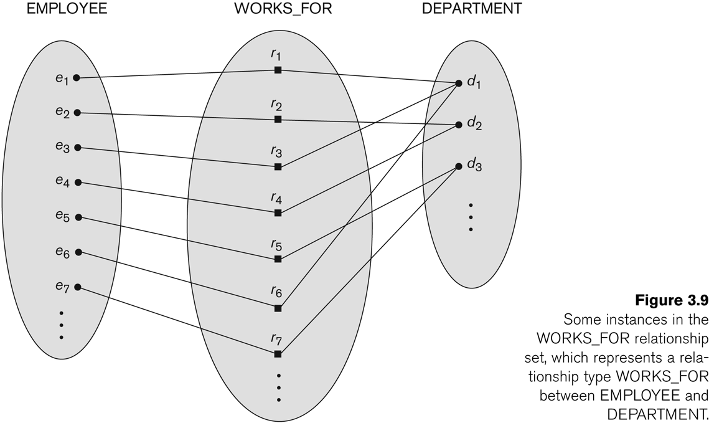
Relationship instances of the WORKS_FOR N:1 relationship between EMPLOYEE and DEPARTMENT

Slide 4
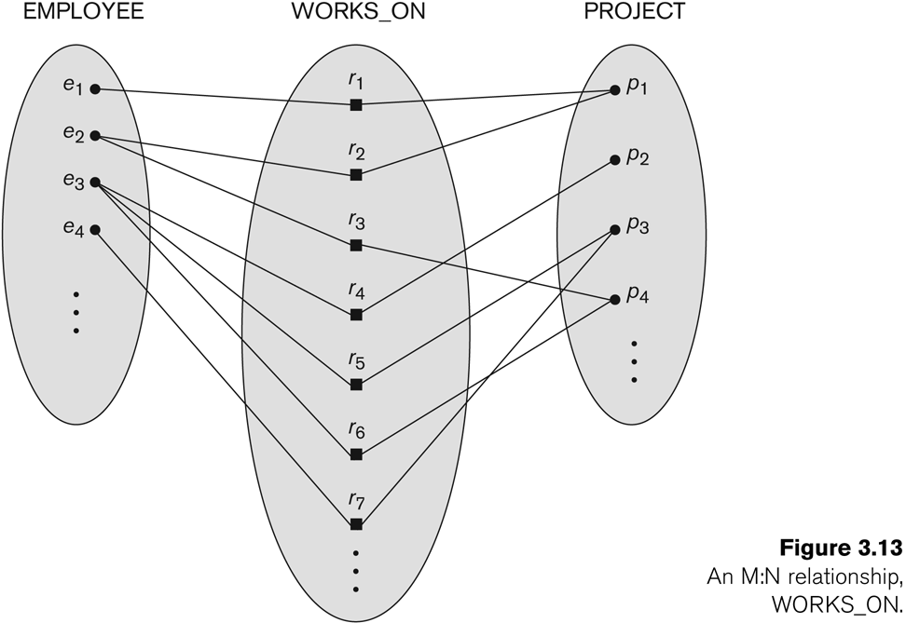
Relationship instances of the M:N WORKS_ON relationship between EMPLOYEE and PROJECT

Slide 5
Relationship type vs. relationship set
Relationship Type:
Is the schema description of a relationship
Identifies the relationship name and the participating entity types
Also identifies certain relationship constraints
Relationship Set:
The current set of relationship instances represented in the database
The current state of a relationship type

Slide 6
Relationship type vs. relationship set
Previous figures displayed the relationship sets
Each instance in the set relates individual participating entities – one from each participating entity type
In ER diagrams, we represent the relationship type as follows:
Diamond-shaped box is used to display a relationship type
Connected to the participating entity types via straight lines
Note that the relationship type is not shown with an arrow. The name should be typically be readable from left to right and top to bottom.

Slide 7
Refining the COMPANY database schema by introducing relationships
By examining the requirements, six relationship types are identified
All are binary relationships( degree 2)
Listed below with their participating entity types:
WORKS_FOR (between EMPLOYEE, DEPARTMENT)
MANAGES (also between EMPLOYEE, DEPARTMENT)
CONTROLS (between DEPARTMENT, PROJECT)
WORKS_ON (between EMPLOYEE, PROJECT)
SUPERVISION (between EMPLOYEE (as subordinate), EMPLOYEE (as supervisor))
DEPENDENTS_OF (between EMPLOYEE, DEPENDENT)

Slide 8
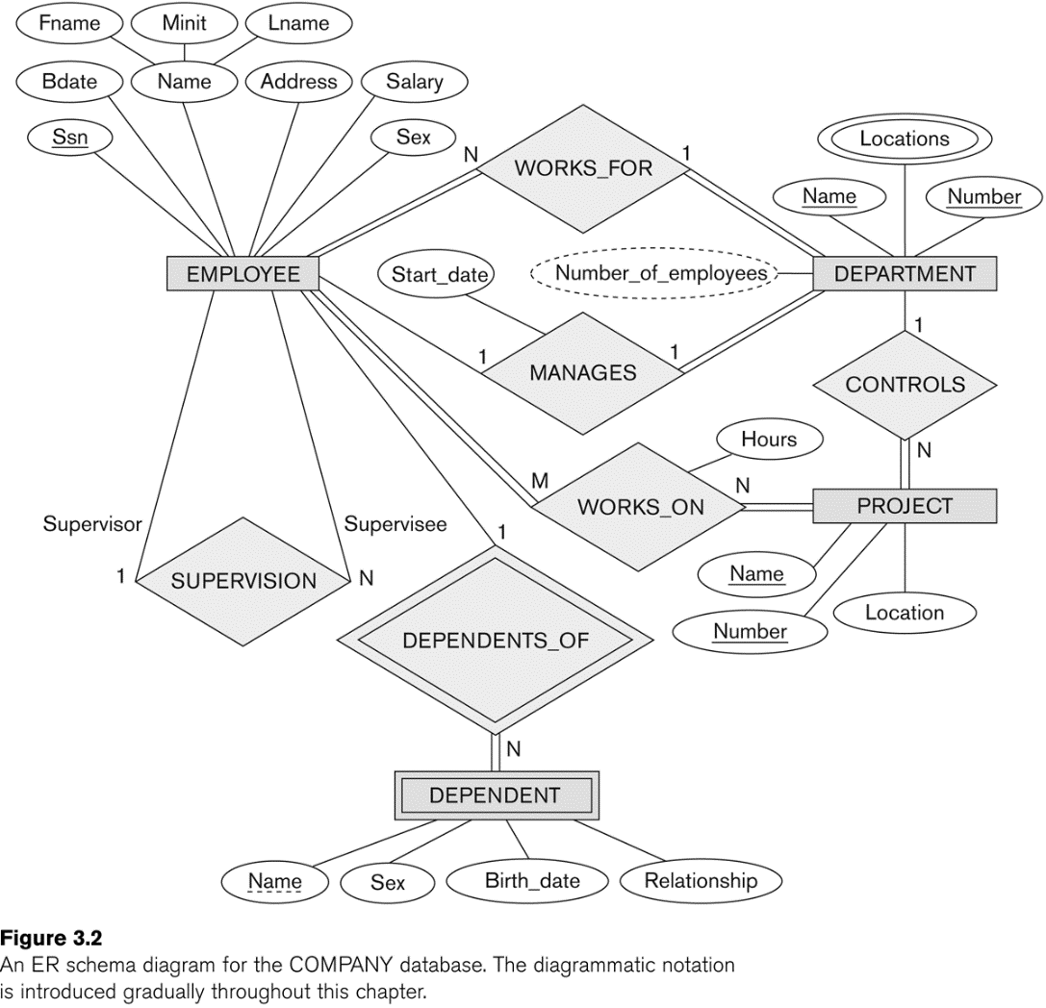
ER Diagram

Slide 9
Discussion on Relationship Types
In the refined design, some attributes from the initial entity types are refined into relationships:
Manager of DEPARTMENT -> MANAGES
Works_on of EMPLOYEE -> WORKS_ON
Department of EMPLOYEE -> WORKS_FOR
etc
In general, more than one relationship type can exist between the same participating entity types
MANAGES and WORKS_FOR are distinct relationship types between EMPLOYEE and DEPARTMENT
Different meanings and different relationship instances.

Slide 10
Constraints on Relationships
Constraints on Relationship Types
(Also known as ratio constraints)
Cardinality Ratio (specifies maximum participation)
One-to-one (1:1)
One-to-many (1:N) or Many-to-one (N:1)
Many-to-many (M:N)
Existence Dependency Constraint (specifies minimum participation) (also called participation constraint)
zero (optional participation, not existence-dependent)
one or more (mandatory participation, existence-dependent)

Slide 11
Many-to-one (N:1) Relationship

Slide 12
Many-to-many (M:N) Relationship

Slide 13
Recursive Relationship Type
A relationship type between the same participating entity type in distinct roles
Also called a self-referencing relationship type.
Example: the SUPERVISION relationship
EMPLOYEE participates twice in two distinct roles:
supervisor (or boss) role
supervisee (or subordinate) role
Each relationship instance relates two distinct EMPLOYEE entities:
One employee in supervisor role
One employee in supervisee role

Slide 14
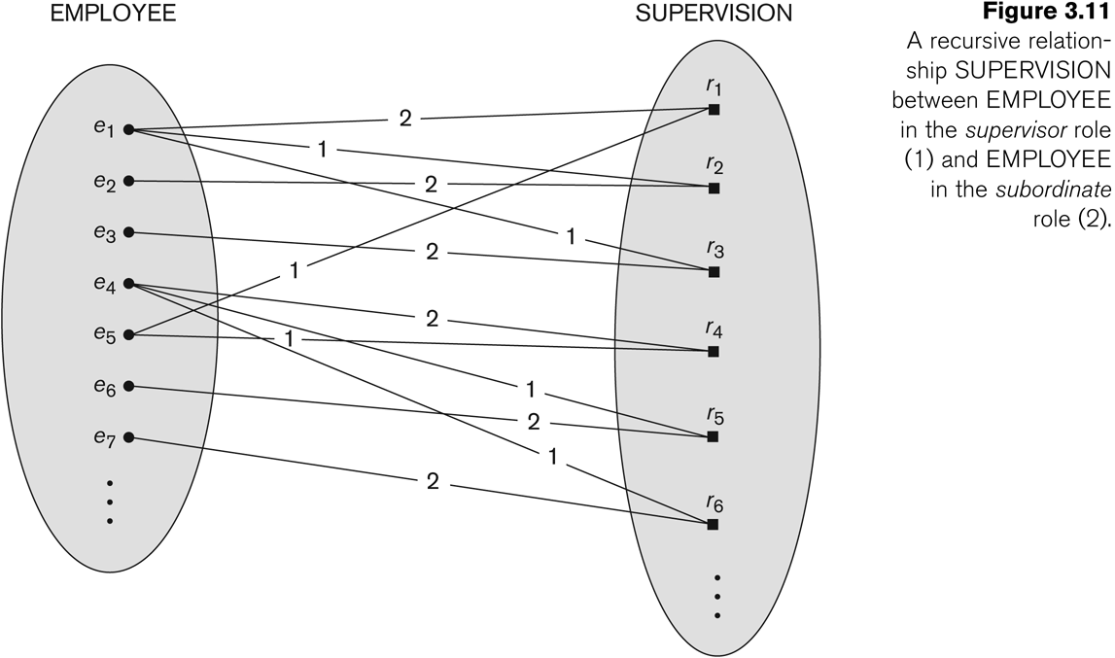
A Recursive Relationship Supervision

Slide 15
Representing a recursive relation in ER diagram

